Slide 1
3413ICT Network Security
Advanced Ciphers
Dr V. Muthukkumarasamy
B.Sc.Eng (Hons) (Peradeniya), PhD (Cantab), MIEE, MIEEE

Slide 2
Previous Lecture…
Have studied…
SSH and VPN
Important ciphers which are useful to network security
Encryption modes for block ciphers, including ECB, CBC, CFB, OFB, CTR

Slide 3
Today’Objectives
Understand linear feedback shift register (LFSR)
Stream Ciphers, RC4
Advanced cipher – AES
Advanced hash functions
Notes:
Now look at a simple form of encryption based on two concepts: the block cipher and the stream cipher.
Stream ciphers are based on a PRNG. The strength of the cipher depends on just how good the PRNG is. Good algorithms employ a lot of state and are highly secure. Stream ciphers must never re-use the same key and many mistakes occur because of this (Word/Excel encryption, WEP and so on).
With the block cipher method, the message is divided into blocks, i.e., 64 or 128 bit blocks, and then each block is transformed using the algorithm and key.

Slide 4
Linear Feedback Shift Registers (LFSR)
Feedback Shift Register:
(“register”, “feedback”, “shift”)
Linear – the feedback function is linear
x_{n}
x_{n-1}
. . . . . . .
x₁
output bits . . . .
feedback fnc.
. . . . . . .
. . . .
x_{n}
x_{n-1}
x₁
⊕

Slide 5
Software-Oriented Stream Ciphers
LFSRs are slow in software
Alternatives:
Block ciphers (or hash functions) in CFB, OFB, CTR modes
Stream ciphers designed for software:
RC4
SEAL (Software-Optimized Encryption Algorithm)

Slide 6
Stream Ciphers
A stream cipher usually generates a pseudo-random key stream, and then xor to the plaintext
They are used in many areas, because of their speed and simplicity of implementation
In addition to data encryption, they are used:
to generate good 0/1sequences for digital communications
to generate keys for one-time pad
to generate session keys, used in:
protocols for network security
wireless communications, etc

Slide 7

RC4
Rivest Cipher 4, by Ron Rivest in 1987
Applications:
SSL, WEP, SSH,
and many other protocols
Professor Ron Rivest
Electrical Engineering & Computer Science
Massachusetts Institute of Technology (MIT)
Procedure:
It first generates a pseudo-random stream of bits (called keystream)
Using the keystream, the plaintext is encrypted making use of the bit-wise exclusive-or operation

Slide 8
RC4 Components
RC4 uses two arrays
A 256-byte state table (also called S-Box)
S[ ]=[ S[0], …, S[255] ]
A key of variable size, consisting of up to 2048 bits (i.e., 256 bytes)
K[ ] = [ K[0], K[1], … ]

Slide 9
RC4 Algorithm
It has 2 counters: i & j and initialised to zero
i = (i + 1) mod 256
j = (j + S_{i} ) mod 256
Swap S_{i} and S_{j}
t = (S_{i} + S_{j} ) mod 256
K = S_{t}
Byte K is XORed with the plaintext to produce ciphertext or XORed with the cipertext to produce plaintext

Slide 10
RC4 Algorithms
S-Box Creation
input key;
if (key < 256 bytes) {
repeat key until 256 bytes;
}
for (i=0; i < 256; ++i) {
S[i] = i; // initialize S-Box
K[i] = i^{th} key byte;
}
j = 0;
for (g = 0; g <256; ++g) {
j = (j + S[i] + K[g]) mod 256;
swap(S[i],S[j]);
}
Keystream Generator
i = 0; j = 0;
loop {
i = (i+1) mod 256;
j = (j+S[i]) mod 256;
Swap(S[i],S[j]);
t = (S[i] + S[j]) mod 256;
ks_byte = S[t];
}
Output S-Box entry (byte) as a byte of the keystream
S-Box: key dependent
permutation of 0 to 255.
Update S-Box entry

Slide 11
The AES Cipher - Rijndael
designed by Rijmen-Daemen in Belgium
has 128/192/256 bit keys, 128 bit data
an iterative rather than feistel cipher
processes data as block of 4 columns of 4 bytes
operates on entire data block in every round
designed to be:
resistant against known attacks
speed and code compactness on many CPUs
design simplicity
Notes:
The Rijndael proposal for AES defined a cipher in which the block length and the key length can be independently specified to be 128,192,or 256 bits. The AES specification uses the same three key size alternatives but limits the block length to 128 bits. Rijndael is an academic submission, based on the earlier Square cipher, from Belgium academics Dr Joan Daemen and Dr Vincent Rijmen. It is an iterative cipher (operates on entire data block in every round) rather than feistel (operate on halves at a time), and was designed to have characteristics of: Resistance against all known attacks, Speed and code compactness on a wide range of platforms, & Design simplicity.

Slide 12
Rijndael
data block of 4 columns of 4 bytes is state
key is expanded to array of words
has 9/11/13 rounds in which state undergoes:
byte substitution (1 S-box used on every byte)
shift rows (permute bytes between groups/columns)
mix columns (subs using matrix multipy of groups)
add round key (XOR state with key material)
view as alternating XOR key & scramble data bytes
initial XOR key material & incomplete last round
with fast XOR & table lookup implementation
Notes:
The input to the AES encryption and decryption algorithms is a single 128-bit block, depicted in FIPS PUB 197, as a square matrix of bytes .This block is copied into the State array, which is modified at each stage of encryption or decryption. After the final stage, State is copied to an output.
The key is expanded into 44/52/60 lots of 32-bit words (see later), with 4 used in each round.
The data computation then consists of an “add round key” step, then 9/11/13 rounds with all 4 steps, and a final 10th/12th/14th step of byte subs + mix cols + add round key. This can be viewed as alternating XOR key & scramble data bytes operations. All of the steps are easily reversed, and can be efficiently implemented using XOR’s & table lookups.

Slide 13
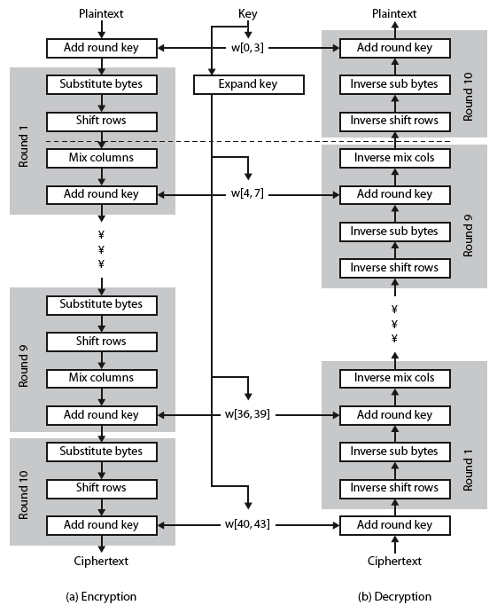
Rijndael
Notes:
Stallings Figure 5.1 shows the overall structure of AES, as detailed on the previous slide.

Slide 14
Byte Substitution
a simple substitution of each byte
uses one table of 16x16 bytes containing a permutation of all 256 8-bit values
each byte of state is replaced by byte indexed by row (left 4-bits) & column (right 4-bits)
eg. byte {95} is replaced by byte in row 9 column 5
which has value {2A}
S-box constructed using defined transformation of values in GF(2⁸)
designed to be resistant to all known attacks
Notes:
Now discuss each of the four stages used in AES. The Substitute bytes stage uses an S-box to perform a byte-by-byte substitution of the block. There is a single 8-bit wide S-box used on every byte. This S-box is a permutation of all 256 8-bit values, constructed using a transformation which treats the values as polynomials in GF(2⁸) – however it is fixed, so really only need to know the table when implementing. Decryption requires the inverse of the table. These tables are given in Stallings Table 4.5.
The table was designed to be resistant to known cryptanalytic attacks. Specifically, the Rijndael developers sought a design that has a low correlation between input bits and output bits, with the property that the output cannot be described as a simple mathematical function of the input, with no fixed points and no “opposite fixed points”.

Slide 15
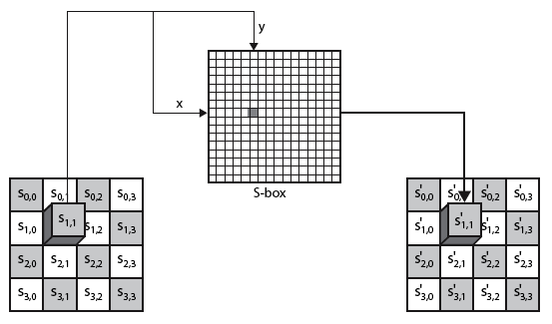
Byte Substitution
Notes:
As this diagram from Stallings Fig 5.4a shows, the Byte Substitution operates on each byte of state independently, with the input byte used to index a row/col in the table to retrieve the substituted value.

Slide 16
Shift Rows
a circular byte shift in each each
1st row is unchanged
2nd row does 1 byte circular shift to left
3rd row does 2 byte circular shift to left
4th row does 3 byte circular shift to left
decrypt inverts using shifts to right
since state is processed by columns, this step permutes bytes between the columns
Notes:
The ShiftRows stage provides a simple “permutation” of the data, whereas the other steps involve substitutions. Further, since the state is treated as a block of columns, it is this step which provides for diffusion of values between columns. It performs a circular rotate on each row of 0, 1, 2 & 3 places for respective rows. When decrypting it performs the circular shifts in the opposite direction for each row. This row shift moves an individual byte from one column to another, which is a linear distance of a multiple of 4 bytes, and ensures that the 4 bytes of one column are spread out to four different columns.

Slide 17
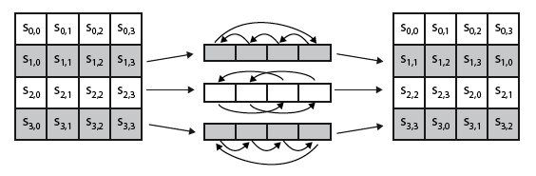
Shift Rows
Notes:
Stalling Figure 5.5a illustrates the Shift Rows permutation.

Slide 18

Mix Columns
each column is processed separately
each byte is replaced by a value dependent on all 4 bytes in the column
effectively a matrix multiplication in GF(2⁸) using prime poly m(x) =x⁸+x⁴+x³+x+1
Notes:
The MixColumns stage is a substitution that makes use of arithmetic over GF(2^8). Each byte of a column is mapped into a new value that is a function of all four bytes in that column. It is designed as a matrix multiplication where each byte is treated as a polynomial in GF(2⁸). The inverse used for decryption involves a different set of constants.
The constants used are based on a linear code with maximal distance between code words – this gives good mixing of the bytes within each column. Combined with the “shift rows” step provides good avalanche, so that within a few rounds, all output bits depend on all input bits.

Slide 19
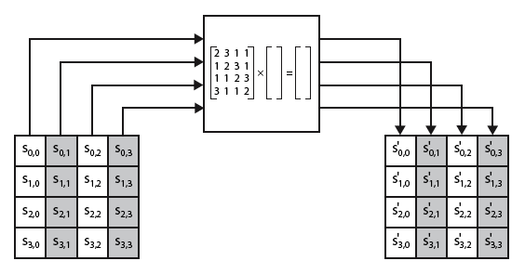
Mix Columns
Notes:
Stalling Figure 5.5b illustrates the Mix Columns transformation.

Slide 20
Mix Columns
can express each col as 4 equations
to derive each new byte in col
decryption requires use of inverse matrix
with larger coefficients, hence a little harder
have an alternate characterisation
each column a 4-term polynomial
with coefficients in GF(2⁸)
and polynomials multiplied modulo (x⁴+1)
Notes:
In practise, you implement Mix Columns by expressing the transformation on each column as 4 equations (Stallings equation 5.4) to compute the new bytes for that column. This computation only involves shifts, XORs & conditional XORs (for the modulo reduction).
The decryption computation requires the use of the inverse of the matrix, which has larger coefficients, and is thus potentially a little harder & slower to implement.
The designers & the AES standard provide an alternate characterisation of Mix Columns, which treats each column of State to be a four-term polynomial with coefficients in GF(2⁸). Each column is multiplied by a fixed polynomial a(x) given in Stallings eqn 5.7. Whilst this is useful for analysis of the stage, the matrix description is all that’s required for implementation.

Slide 21
Add Round Key
XOR state with 128-bits of the round key
again processed by column (though effectively a series of byte operations)
inverse for decryption identical
since XOR own inverse, with reversed keys
designed to be as simple as possible
a form of Vernam cipher on expanded key
requires other stages for complexity / security
Notes:
Lastly is the Add Round Key stage which is a simple bitwise XOR of the current block with a portion of the expanded key. Note this is the only step which makes use of the key and obscures the result, hence MUST be used at start and end of each round, since otherwise could undo effect of other steps. But the other steps provide confusion/diffusion/non-linearity. That us you can look at the cipher as a series of XOR with key then scramble/permute block repeated. This is efficient and highly secure it is believed.

Slide 22
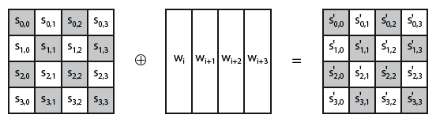
Add Round Key
Notes:
Stallings Figure 5.4b illustrates the Add Round Key stage, which like Byte Substitution, operates on each byte of state independently.

Slide 23
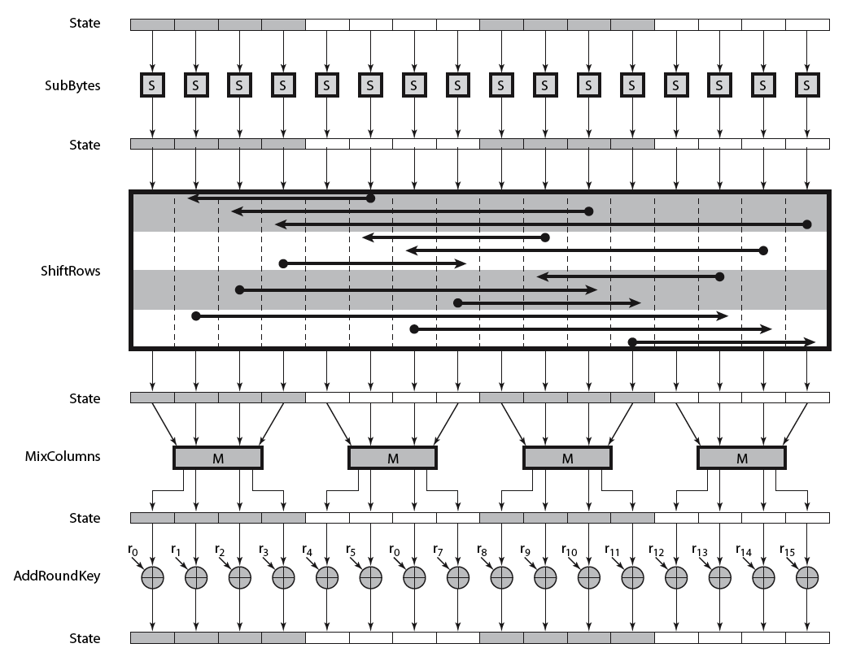
AES Round
Notes:
Can thus now view all the internal details of the AES round, showing how each byte of the state is manipulated, as shown in Stallings Figure 5.3.

Slide 24
AES Key Expansion
takes 128-bit (16-byte) key and expands into array of 44/52/60 32-bit words
start by copying key into first 4 words
then loop creating words that depend on values in previous & 4 places back
in 3 of 4 cases just XOR these together
1st word in 4 has rotate + S-box + XOR round constant on previous, before XOR 4th back
Notes:
The AES key expansion algorithm takes as input a 4-word (16-byte) key and produces a linear array of words, providing a 4-word round key for the initial AddRoundKey stage and each of the 10/12/14 rounds of the cipher. It involves copying the key into the first group of 4 words, and then constructing subsequent groups of 4 based on the values of the previous & 4th back words. The first word in each group of 4 gets “special treatment” with rotate + S-box + XOR constant on the previous word before XOR’ing the one from 4 back. In the 256-bit key/14 round version, there’s also an extra step on the middle word.

Slide 25
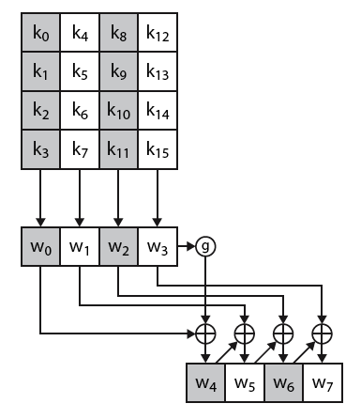
AES Key Expansion
Notes:
The first block of the AES Key Expansion is shown here in Stallings Figure 5.6. It shows each group of 4 bytes in the key being assigned to the first 4 words, then the calculation of the next 4 words based on the values of the previous 4 words, which is repeated enough times to create all the necessary subkey information.

Slide 26
Key Expansion Rationale
designed to resist known attacks
design criteria included
knowing part key insufficient to find many more
invertible transformation
fast on wide range of CPU’s
use round constants to break symmetry
diffuse key bits into round keys
enough non-linearity to hinder analysis
simplicity of description
Notes:
The Rijndael developers designed the expansion key algorithm to be resistant to known cryptanalytic attacks. It is designed to be simple to implement, but by using round constants break symmetries, and make it much harder to deduce other key bits if just some are known (but once have as many consecutive bits as are in key, can then easily recreate the full expansion). The design criteria used are listed above.

Slide 27
AES decryption
AES decryption uses essentially the same algorithm, with the following changes:
The inverse of the four main operations are used
These consists simply of using a different set of lookup tables
The round keys are used in the reverse order

Slide 28
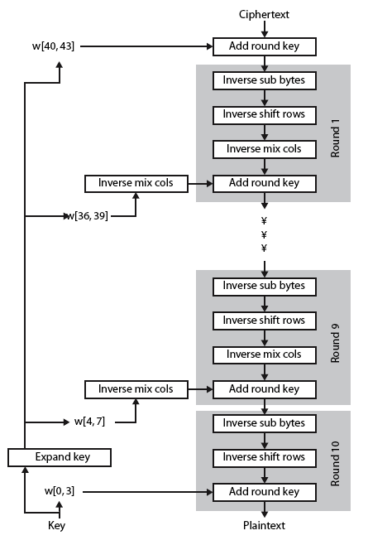
AES Decryption
Notes:
Illustrate the equivalent inverse cipher with Stallings Figure 5.7.

Slide 29
Implementation Aspects
can efficiently implement on 8-bit CPU
byte substitution works on bytes using a table of 256 entries
shift rows is simple byte shift
add round key works on byte XOR’s
mix columns requires matrix multiply in GF(2⁸) which works on byte values, can be simplified to use table lookups & byte XOR’s
Notes:
AES can be implemented very efficiently on an 8-bit processor.
AddRoundKey is a bytewise XOR operation.
ShiftRows is a simple byte shifting operation.
SubBytes operates at the byte level and only requires a lookup of a 256 byte table S.
MixColumns (matrix multiply) can be implemented as byte XOR’s & table lookups with a 2nd 256 byte table X2, using the formulae shown in Stallings equation 5.9.

Slide 30
Implementation Aspects
can efficiently implement on 32-bit CPU
redefine steps to use 32-bit words
can precompute 4 tables of 256-words
then each column in each round can be computed using 4 table lookups + 4 XORs
at a cost of 4Kb to store tables
designers believe this very efficient implementation was a key factor in its selection as the AES cipher
Notes:
AES can also be very efficiently implemented on an 32-bit processor, by rewriting the stage transformation to use 4 table lookups & 4 XOR’s per column of state. These tables can be computed in advance using the formulae shown in the text, and need 4Kb to store.
The developers of Rijndael believe that this compact, efficient implementation was probably one of the most important factors in the selection of Rijndael for AES.

Slide 31
Hash and MAC Algorithms
Hash Functions
condense arbitrary size message to fixed size
by processing message in blocks
through some compression function
either custom or block cipher based
Message Authentication Code (MAC)
fixed sized authenticator for some message
to provide authentication for message
by using block cipher mode or hash function
Notes:
Now look at important examples of both secure hash functions and message authentication codes (MACs).
Traditionally, most hash functions that have achieved widespread use rely on a compression function specifically designed for the hash function. Another approach is to use a symmetric block cipher as the compression function.
MACs also fall into two categories: some use a hash algorithm such as SHA as the core of the MAC algorithm, others use a symmetric block cipher in a cipher block chaining mode.

Slide 32
Requirements for Hash Functions
can be applied to any sized message M
produces fixed-length output h
is easy to compute h=H(M) for any message M
given h is infeasible to find x s.t. H(x)=h
one-way property
given x is infeasible to find y s.t. H(y)=H(x)
weak collision resistance
is infeasible to find any x,y s.t. H(y)=H(x)
strong collision resistance
Notes:
The purpose of a hash function is to produce a “fingerprint”of a file, message, or other block of data.
These are the specifications for good hash functions. Essentially it must be extremely difficult to find 2 messages with the same hash, and the hash should not be related to the message in any obvious way (ie it should be a complex non-linear function of the message). There are quite a few similarities in the evolution of hash functions & block ciphers, and in the evolution of the design requirements on both.

Slide 33
Simple Hash Functions
are several proposals for simple functions
based on XOR of message blocks
not secure since can manipulate any message and either not change hash or change hash also
need a stronger cryptographic function (next chapter)
Notes:
All hash functions operate using the following general principles. The input (message, file,etc.) is viewed as a sequence of n-bit blocks, processed one block at a time in an iterative fashion to produce an n-bit hash function. Can construct a range of possible simple hash functions by just XOR’ing blocks with rotates etc. None of these are secure, since can predict how changes to message affect the resulting hash.

Slide 34
Birthday Attacks
might think a 64-bit hash is secure
but by Birthday Paradox is not
birthday attack works thus:
opponent generates 2^{m/2} variations of a valid message all with essentially the same meaning
opponent also generates 2^{m/2} variations of a desired fraudulent message
two sets of messages are compared to find pair with same hash (probability > 0.5 by birthday paradox)
have user sign the valid message, then substitute the forgery which will have a valid signature
conclusion is that need to use larger MAC/hash
Notes:
The Birthday Attack exploits the birthday paradox – the chance that in a group of people two will share the same birthday – only 23 people are needed for a Pr>0.5 of this. Can generalize the problem to one wanting a matching pair from any two sets, and show need 2^{m/2} in each to get a matching m-bit hash.
Note that creating many message variants is relatively easy, either by rewording or just varying the amount of white-space in the message. All of which indicates that larger MACs/Hashes are needed.

Slide 35
Block Ciphers as Hash Functions
can use block ciphers as hash functions
using H₀=0 and zero-pad of final block
compute: H_{i} = E_{Mi} [H_{i-1}]
and use final block as the hash value
similar to CBC but without a key
resulting hash is too small (64-bit)
both due to direct birthday attack
and to “meet-in-the-middle” attack
other variants also susceptible to attack
Notes:
A number of proposals have been made for hash functions based on using a cipher block chaining technique, but without the secret key (instead using the message blocks as keys). Unfortunately these are subject to both the birthday attack, and to a “meet-in-the-middle” attack. Thus, attention has been directed at finding other approaches to hashing.

Slide 36
Hash Functions & MAC Security
like block ciphers have:
brute-force attacks exploiting
strong collision resistance hash have cost 2^{m/2}
have proposal for h/w MD5 cracker
128-bit hash looks vulnerable, 160-bits better
MACs with known message-MAC pairs
can either attack keyspace (cf key search) or MAC
at least 128-bit MAC is needed for security
Notes:
Just as with symmetric and public-key encryption, we can group attacks on hash functions and MACs into two categories: brute-force attacks and cryptanalysis.
The strength of a hash function against brute-force attacks depends solely on the length of the hash code produced by the algorithm, with cost O(2^m/2). See proposal in text for a h/w MD5 cracker.
A brute-force attack on a MAC is a more difficult undertaking because it requires known message-MAC pairs. However analysis shows cost is related to min(2^k, 2^n), similar to symmetric encryption algorithms.

Slide 37
Hash Functions & MAC Security
cryptanalytic attacks exploit structure
like block ciphers want brute-force attacks to be the best alternative
have a number of analytic attacks on iterated hash functions
CV_{i} = f[CV_{i-1}, M_{i}]; H(M)=CV_{N}
typically focus on collisions in function f
like block ciphers is often composed of rounds
attacks exploit properties of round functions
Notes:
As with encryption algorithms, cryptanalytic attacks on hash functions and MAC algorithms seek to exploit some property of the algorithm to perform some attack other than an exhaustive search. The way to measure the resistance of a hash or MAC algorithm to cryptanalysis is to compare its strength to the effort required for a brute-force attack. That is, an ideal hash or MAC algorithm will require a cryptanalytic effort greater than or equal to the brute-force effort.
Cryptanalysis of hash functions focuses on the internal structure of the compression function f and is based on attempts to find efficient techniques for producing collisions for a single execution of f. Keep in mind that for any hash function there must exist collisions, but want it to be computationally infeasible to find these collisions.

Slide 38
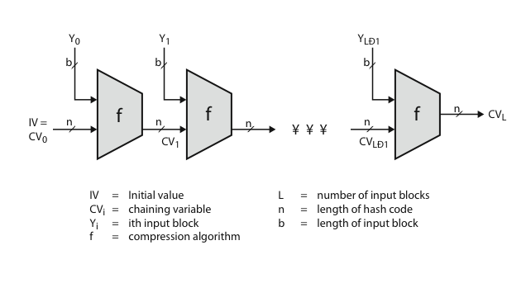
Hash Algorithm Structure
Notes:
Most important modern hash functions follow the basic structure shown in this figure, Stallings Figure 11.9. This has proved to be a fundamentally sound structure, and newer designs simply refine the structure and add to the hash code length. Within this basic structure, two approaches have been followed in the design of the compression function, as mentioned previously, which is the basic building block of the hash function.

Slide 39
Secure Hash Algorithm
SHA originally designed by NIST & NSA in 1993
was revised in 1995 as SHA-1
US standard for use with DSA signature scheme
standard is FIPS 180-1 1995, also Internet RFC3174
nb. the algorithm is SHA, the standard is SHS
based on design of MD4 with key differences
produces 160-bit hash values
recent 2005 results on security of SHA-1 have raised concerns on its use in future applications
Notes:
The Secure Hash Algorithm (SHA) was developed by the National Institute of Standards and Technology (NIST) and published as a federal information processing standard (FIPS 180) in 1993; a revised version was issued as FIPS 180-1 in 1995 and is generally referred to as SHA-1. The actual standards document is entitled Secure Hash Standard. SHA is based on the hash function MD4 and its design closely models MD4. SHA-1 produces a hash value of 160 bits. In 2005, a research team described an attack in which two separate messages could be found that deliver the same SHA-1 hash using 2^69 operations, far fewer than the 2^80 operations previously thought needed to find a collision with an SHA-1 hash [WANG05]. This result should hasten the transition to newer, longer versions of SHA.

Slide 40
Revised Secure Hash Standard
NIST issued revision FIPS 180-2 in 2002
adds 3 additional versions of SHA
SHA-256, SHA-384, SHA-512
designed for compatibility with increased security provided by the AES cipher
structure & detail is similar to SHA-1
hence analysis should be similar
but security levels are rather higher
Notes:
In 2002, NIST produced a revised version of the standard, FIPS 180-2, that defined three new versions of SHA, with hash value lengths of 256, 384, and 512 bits, known as SHA-256, SHA-384, and SHA-512. These new versions have the same underlying structure and use the same types of modular arithmetic and logical binary operations as SHA-1, hence analyses should be similar. In 2005, NIST announced the intention to phase out approval of SHA-1 and move to a reliance on the other SHA versions by 2010. See Stallings Table12.1 for comparative details of these algorithms.

Slide 41
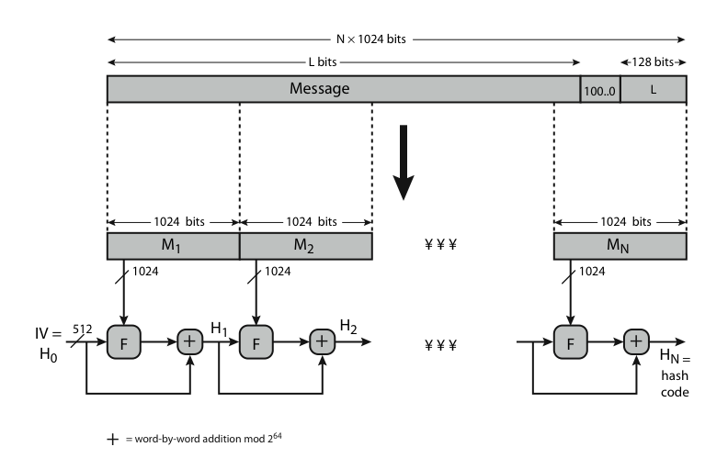
SHA-512 Overview
Notes:
Now examine the structure of SHA-512, noting that the other versions are quite similar.
SHA-512 follows the structure depicted in Stallings Figure 12.1. The processing consists of the following steps:
• Step 1: Append padding bits
• Step 2: Append length
• Step 3: Initialize hash buffer
• Step 4: Process the message in 1024-bit (128-word) blocks, which forms the heart of the algorithm
• Step 5: Output the final state value as the resulting hash
See text for details.

Slide 42
SHA-512 Compression Function
heart of the algorithm
processing message in 1024-bit blocks
consists of 80 rounds
updating a 512-bit buffer
using a 64-bit value Wt derived from the current message block
and a round constant based on cube root of first 80 prime numbers
Notes:
The SHA-512 Compression Function is the heart of the algorithm. In this Step 4, it processes the message in 1024-bit (128-word) blocks, using a module that consists of 80 rounds, labeled F in Stallings Figure 12, as shown in Figure 12.2. Each round takes as input the 512-bit buffer value, and updates the contents of the buffer. Each round t makes use of a 64-bit value Wt derived using a message schedule from the current 1024-bit block being processed. Each round also makes use of an additive constant Kt, based on the fractional parts of the cube roots of the first eighty prime numbers. The output of the eightieth round is added to the input to the first round to produce the final hash value for this message block, which forms the input to the next iteration of this compression function, as shown on the previous slide.

Slide 43
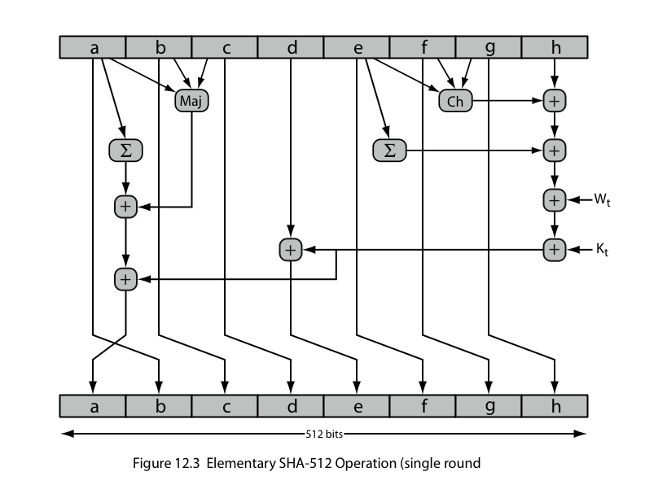
SHA-512 Round Function
Notes:
The structure of each of the 80 rounds is shown in Stallings Figure 12.3. Each 64-bit word shuffled along one place, and in some cases manipulated using a series of simple logical functions (ANDs, NOTs, ORs, XORs, ROTates), in order to provide the avalanche & completeness properties of the hash function. The elements are:
Ch(e,f,g) = (e AND f) XOR (NOT e AND g)
Maj(a,b,c) = (a AND b) XOR (a AND c) XOR (b AND c)
∑(a) = ROTR(a,28) XOR ROTR(a,34) XOR ROTR(a,39)
∑(e) = ROTR(e,14) XOR ROTR(e,18) XOR ROTR(e,41)
+ = addition modulo 2^64
Kt = a 64-bit additive constant
Wt = a 64-bit word derived from the current 512-bit input block.

Slide 44
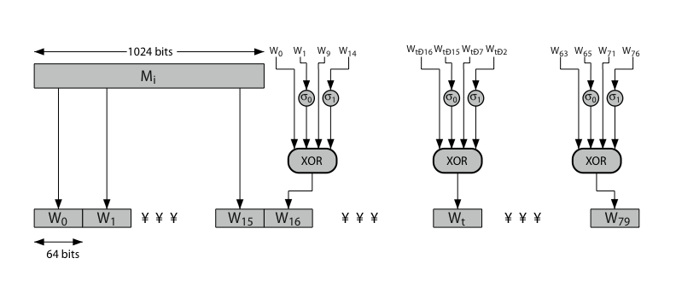
SHA-512 Round Function
Notes:
Stallings Figure 12.4 details how the 64-bit word values Wt are derived from the 1024-bit message. The first 16 values of Wt are taken directly from the 16 words of the current block. The remaining values are defined as a function of the earlier values using ROTates, SHIFTs and XORs as shown. The function elements are:
∂0(x) = ROTR(x,1) XOR ROTR(x,8) XOR SHR(x,7)
∂1(x) = ROTR(x,19) XOR ROTR(x,61) XOR SHR(x,6).

Slide 45
Whirlpool
now examine the Whirlpool hash function
endorsed by European NESSIE project
uses modified AES internals as compression function
addressing concerns on use of block ciphers seen previously
with performance comparable to dedicated algorithms like SHA
Notes:
Next examine the hash function Whirlpool [BARR03]. Whirlpool is one of only two hash functions endorsed by the NESSIE (New European Schemes for Signatures, Integrity, and Encryption) project, a European Union–sponsored effort to put forward a portfolio of strong cryptographic primitives of various types. Whirlpool is based on the use of a modified AES block cipher as the compression function, and is intended to provide security and performance that is comparable, if not better, than that found in non block-cipher based hash functions, such as the MD or SHA families.

Slide 46
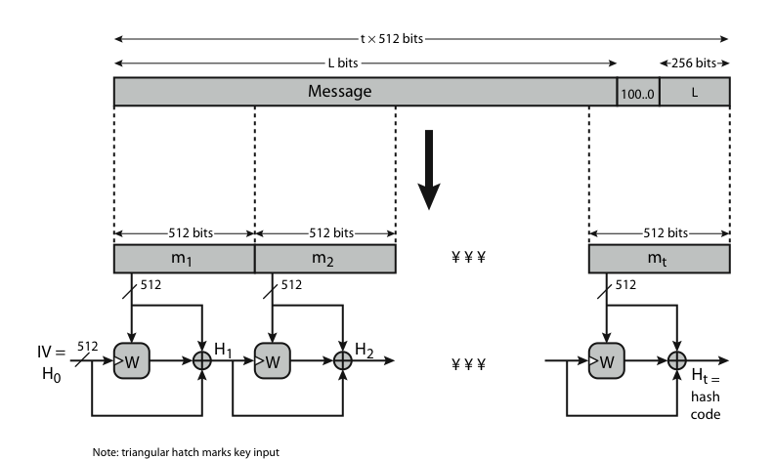
Whirlpool Overview
Notes:
Stallings Figure 12.6 shows an overview of Whirlpool, which takes as input a message with a maximum length of less than 2^256 bits and produces as output a 512-bit message digest. The input is processed in 512-bit blocks. The processing consists of the following steps:
• Step 1: Append padding bits
• Step 2: Append length
• Step 3: Initialize hash matrix
• Step 4: Process message in 512-bit (64-byte) blocks, using as its core, the block cipher W.

Slide 47
Whirlpool Block Cipher W
designed specifically for hash function use
with security and efficiency of AES
but with 512-bit block size and hence hash
similar structure & functions as AES but
input is mapped row wise
has 10 rounds
a different primitive polynomial for GF(2^8)
uses different S-box design & values
Notes:
Unlike virtually all other proposals for a block-cipher-based hash function, Whirlpool uses a block cipher that is specifically designed for use in the hash function and that is unlikely ever to be used as a standalone encryption function. The reason for this is that the designers wanted to make use of an block cipher with the security and efficiency of AES but with a hash length that provided a potential security equal to SHA-512. The result is the block cipher W, which has a similar structure and uses the same elementary functions as AES, but which uses a block size and a key size of 512 bits. See Stallings Table12.2 which compares AES and W.

Slide 48
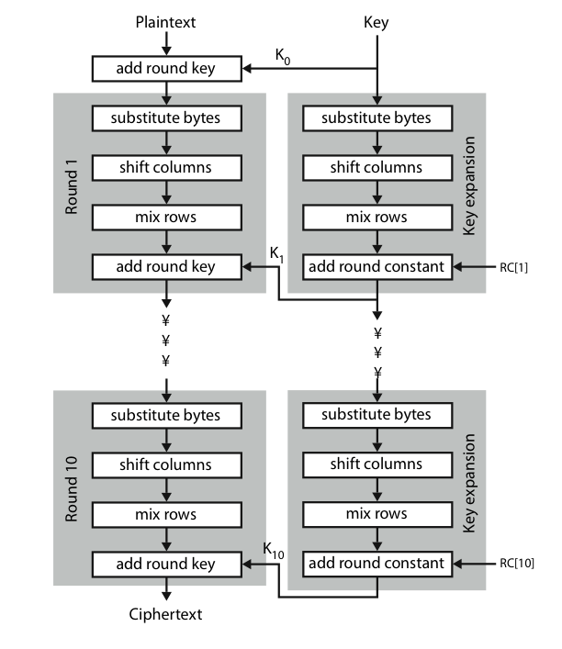
Whirlpool Block Cipher W
Notes:
Stallings Figure 12.7 shows the structure of Block Cipher W. The encryption algorithm takes a 512-bit block of plaintext as input and a 512-bit key and produces a 512-bit block of ciphertext as output. The encryption algorithm involves the use of four different functions, or transformations: add key (AK), substitute bytes (SB), shift columns (SC), and mix rows (MR). Note that the input is mapped by rows (unlike AES which is mapped by column). Hence the use of “Mix Rows” as the diffusion layer; and “Shift Columns” as the permutation (vs Mix Columns & Shift Rows in AES). Note also that the Key Schedule uses the same W round function, but with round constants RC[I] (being S-box outputs) taking the role of “subkeys” in the AddKey function.

Slide 49
Whirlpool Performance & Security
Whirlpool is a very new proposal
hence little experience with use
but many AES findings should apply
does seem to need more h/w than SHA, but with better resulting performance
Notes:
Whirlpool is a very new proposal, hence there is little experience with use, though many AES findings should apply to it. As yet, there has been little implementation experience with Whirlpool. One study [KITS04] compared Whirlpool with a number of other secure hash functions. The authors developed multiple hardware implementations of each hash function and concluded that, compared to SHA-512, Whirlpool requires more hardware resources but performs much better in terms of throughput.

Slide 50
Keyed Hash Functions as MACs
want a MAC based on a hash function
because hash functions are generally faster
code for crypto hash functions widely available
hash includes a key along with message
original proposal:
KeyedHash = Hash(Key|Message)
some weaknesses were found with this
eventually led to development of HMAC
Notes:
In recent years, there has been increased interest in developing a MAC derived from a cryptographic hash function. A hash function such as SHA was not designed for use as a MAC and cannot be used directly for that purpose because it does not rely on a secret key. There have been a number of proposals for the incorporation of a secret key into an existing hash algorithm, originally by just pre-pending a key to the message. Problems were found with these earlier, simpler proposals, but they resulted in the development of HMAC.

Slide 51
HMAC
specified as Internet standard RFC2104
uses hash function on the message:
HMAC_{K} = Hash[(K⁺ XOR opad) ||
Hash[(K⁺ XOR ipad)||M)]]
where K⁺ is the key padded out to size
and opad, ipad are specified padding constants
overhead is just 3 more hash calculations than the message needs alone
any hash function can be used
eg. MD5, SHA-1, RIPEMD-160, Whirlpool
Notes:
The idea of a keyed hash evolved into HMAC, designed to overcome some problems with the original proposals. It involves hashing padded versions of the key concatenated with the message, and then with another outer hash of the result prepended by another padded variant of the key. The hash function need only be used on 3 more blocks than when hashing just the original message (for the two keys + inner hash). HMAC can use any desired hash function, and has been shown to have the same security as the underlying hash function. Can choose the hash function to use based on speed/security concerns.

Slide 52
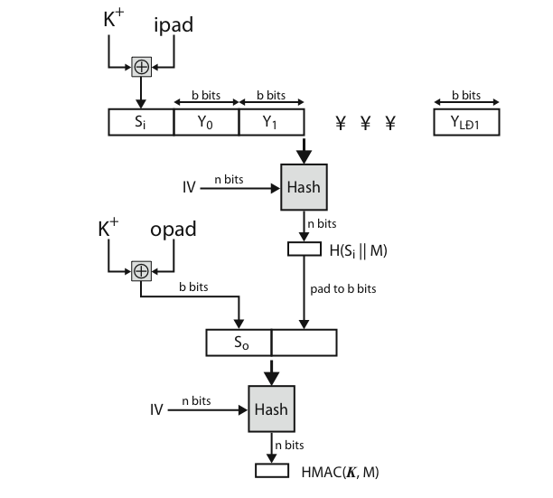
HMAC Overview
Notes:
Stallings Figure 12.10 shows the structure of HMAC, which implements the function:
HMAC_{K} = Hash[(K⁺ XOR opad) || Hash[(K⁺ XOR ipad) || M)]
elements are:
K⁺ is K padded with zeros on the left so that the result is b bits in length
ipad is a pad value of 36 hex repeated to fill block
opad is a pad value of 5C hex repeated to fill block
M is the message input to HMAC (including the padding specified in the embedded hash function)

Slide 53
HMAC Security
proved security of HMAC relates to that of the underlying hash algorithm
attacking HMAC requires either:
brute force attack on key used
birthday attack (but since keyed would need to observe a very large number of messages)
choose hash function used based on speed verses security constraints
Notes:
The appeal of HMAC is that its designers have been able to prove an exact relationship between the strength of the embedded hash function and the strength of HMAC. The security of a MAC function is generally expressed in terms of the probability of successful forgery with a given amount of time spent by the forger and a given number of message-MAC pairs created with the same key. Have two classes of attacks: brute force attack on key used which has work of order 2^n; or a birthday attack which requires work of order 2^(n/2) - but which requires the attacker to observe 2^n blocks of messages using the same key - very unlikely. So even MD5 is still secure for use in HMAC given these constraints.

Slide 54
CMAC
previously saw the DAA (CBC-MAC)
widely used in govt & industry
but has message size limitation
can overcome using 2 keys & padding
thus forming the Cipher-based Message Authentication Code (CMAC)
adopted by NIST SP800-38B
Notes:
CMAC was previously described as the Data Authentication Algorithm, FIPS PUB 113, also known as the CBC-MAC (cipher block chaining message authentication code). This cipher-based MAC has been widely adopted in government and industry. Has been shown to be secure, with the following restriction. Only messages of one fixed length of mn bits are processed, where n is the cipher block size and m is a fixed positive integer. This limitation can be overcome using multiple keys, which can be derived from a single key. This refinement has been adopted by NIST as the cipher-based message authentication code (CMAC) mode of operation, for use with AES and triple DES. It is specified in NIST Special Publication 800-38B.

Slide 55
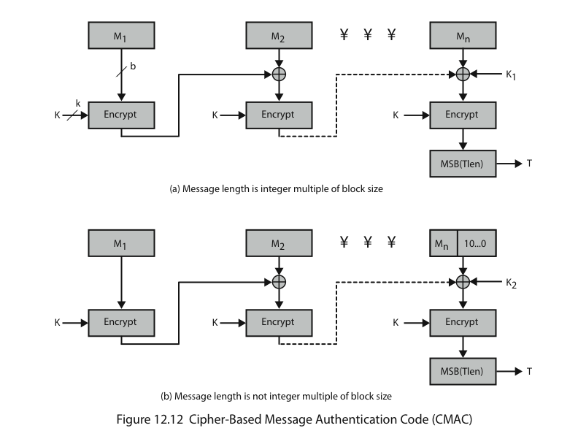
CMAC Overview
Notes:
Stallings Figure 12.12 shows the structure of CMAC.
It uses the blocksize of the underlying cipher (ie 128-bits for AES or 64-bits for triple-DES). The message is divided into n blocks M1..Mn, padded if necessary. The algorithm makes use of a k-bit encryption key K and an n-bit constant K1 or K2 (depending on whether the message was padded or not). For AES, the key size k is 128,192, or 256 bits; for triple DES, the key size is 112 or 168 bits. The two constants K1 & K2 are derived from the original key K using encryption of 0 and multiplication in GF(2^n), as detailed in the text.

Slide 56
Summary
We have studied
Linear feedback shift registers (LFSRs)
Stream Ciphers
AES
Advanced hash functions
SHA-512 & Whirlpool
HMAC authentication using hash function
CMAC authentication using a block cipher

Slide 57
Next Lecture
Mid-Semester Exam…

Slide 58

Questions?

